Slide 1





WAN LINKS MIGRATION
Executive Summary
7 services on 17 physical links across 2 locations (DOZ & DR) and 2 ISPs — every service is flagged for migration.
7
17
2
2
Services in scope
Physical links
Locations
ISPs
All with end goal “Migrate”
7 primary · 5 secondary · 5 backup
DOZ 11 links · DR 6 links
Etisalat 14 links · Du 3 links
Service | ISP | DOZ | DR | Links | Port bandwidth
GPRS | Etisalat | Primary · Secondary | Backup | 3 | 3 × 100 Mbps
Etisalat Payment GW (DSG-Comtrust) | Etisalat | Primary | Backup | 2 | 8 Mbps (DOZ) + 2 Mbps (DR)
Dubai Police | Etisalat | Primary | Backup | 2 | 2 × 8 Mbps
Carrefour | Etisalat | Primary | Secondary | 2 | 2 × 1 Mbps
RTA NOL | Etisalat | Primary · Secondary | — | 2 | 2 × 1 Mbps
CBUAE | Etisalat | Primary · Secondary | Backup | 3 | 3 × 8 Mbps + MGMT 128 Kbps
Du POS links | Du | Primary · Secondary | Backup | 3 | 3 × 512 Kbps
Total | 2 ISPs | 11 links | 6 links | 17 | Aggregate
AMEX, JCB, CUP are live for production services at NEOPAY over Internet VPN, serving transaction authorization from 7th Sep 2026.
Mastercard & VISA connection will stay at Mashreq DC
Notes:
Scope: 7 services on 17 physical links — Etisalat 14, Du 3 — across DOZ (11 links) and DR (6 links). Every service carries the end goal "Migrate". Aggregate provisioned port bandwidth is about 355.5 Mbps, of which Etisalat GPRS accounts for 300 Mbps. CBUAE Certax (128 Kbps) rides the same DR link as CBUAE data backup.

Slide 2


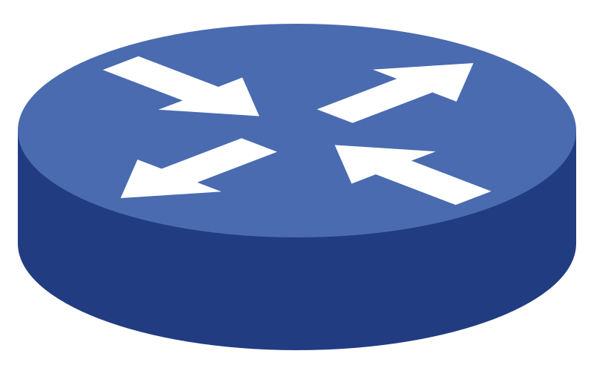



WAN LINKS MIGRATION
POS Traffic Flow & Connectivity | Pilot
Transaction path: POS terminal → ISP GPRS cloud → Mashreq DC → GRE tunnel over ISP dedicated VRF → Postilion at NeoPay DC
Transaction Latency
Environment | du | e&
Mashreq Production | Avg. 4 S 42 ms to 5 S 17 ms | Avg. 2 S 51 ms to 3 S 37 ms
Neopay pilot Production | Avg. 4 S 62 ms to 5 S 43 ms | Avg. 2 S 65 ms to 3 S 59 ms
Increased Latency | 20-26 ms | 14-27 ms
Etisalat GPRS Cloud
3 × 100 Mbps links to Mashreq
4 × GRE tunnels · Mashreq ↔ NeoPay
Mashreq
DOZ
Etisalat
VRF Cloud
KDC
Primary Datacenter
Primary Datacenter
Postilion Server (RT3)
GPRS
Server Live from 7th Sep
Inter-DC link · 10G
Inter-DC link · 2G
POS Machine
DXB
End-point device
Mashreq
KDC
Secondary Datacenter
Secondary Datacenter
Du
VRF Cloud
Postilion Server (RT4)
Du GPRS Cloud
4 × GRE tunnels · Mashreq ↔ NeoPay
Server will be live on 8th Oct
3 × 512 Kbps links to Mashreq
Etisalat link on DR is not available now
Expected link delivery 7th Oct
Etisalat physical link
Etisalat GRE tunnel
Du physical link
Du GRE tunnel
Inter-DC link
GPRS radio link
Notes:
POS terminals reach the Etisalat or Du GPRS cloud over GPRS. Each GPRS cloud is physically connected to both Mashreq datacenters, which are joined by a 10G inter-DC link. Each Mashreq DC has one physical link into each ISP's dedicated VRF cloud, and each NeoPay DC has one physical link from each ISP's VRF cloud. Four GRE tunnels per ISP form a full mesh between the two Mashreq DCs and the two NeoPay DCs, delivering traffic to the Postilion servers. The NeoPay DCs are joined by a 2G inter-DC link.

Slide 3
WAN LINKS MIGRATION
POS Traffic Flow & Connectivity | Transition State
All POS transaction at Neopay
Transaction path: POS terminal → ISP GPRS cloud → Mashreq DC → GRE tunnel over ISP dedicated VRF → Postilion at NeoPay DC
Transaction Latency
Environment | du | e&
Mashreq Production | Avg. 4 S 42 ms to 5 S 17 ms | Avg. 2 S 51 ms to 3 S 37 ms
Neopay pilot Production | Avg. 4 S 62 ms to 5 S 43 ms | Avg. 2 S 65 ms to 3 S 59 ms
Increased Latency | 20-26 ms | 14-27 ms
Etisalat GPRS Cloud
3 × 100 Mbps links to Mashreq
4 × GRE tunnels · Mashreq ↔ NeoPay
Mashreq
DOZ
Etisalat
VRF Cloud
KDC
Primary Datacenter
Primary Datacenter
Postilion Server (RT3)
GPRS
Server Live from 7th Sep
POS Machine
Inter-DC link · 10G
Inter-DC link · 2G
End-point device
RISK on operating the services via Mashreq for 2 Mondsh
Overall negligible latency 14-27 ms
No of hops increases (4)
Operation dependency with Mashreq
ITSM team alignment which touches the path
Potential ETA increases for resolution for incident
Mashreq
DXB
DR
Secondary Datacenter
Secondary Datacenter
Du
VRF Cloud
Postilion Server (RT4)
Du GPRS Cloud
4 × GRE tunnels · Mashreq ↔ NeoPay
Server will be live on 8th Oct
3 × 512 Kbps links to Mashreq
Etisalat link on DR is not available now
Expected link delivery 7th Oct
Etisalat physical link
Etisalat GRE tunnel
Du physical link
Du GRE tunnel
Inter-DC link
GPRS radio link
Mashreq – NEOPAY need to agree the risk of operation model for 2 months, till the links are delivered at NEOPAY.
Mastercard & VISA connection will stay at Mashreq DC, the cross-connectivity risk still open for a year
Notes:
POS terminals reach the Etisalat or Du GPRS cloud over GPRS. Each GPRS cloud is physically connected to both Mashreq datacenters, which are joined by a 10G inter-DC link. Each Mashreq DC has one physical link into each ISP's dedicated VRF cloud, and each NeoPay DC has one physical link from each ISP's VRF cloud. Four GRE tunnels per ISP form a full mesh between the two Mashreq DCs and the two NeoPay DCs, delivering traffic to the Postilion servers. The NeoPay DCs are joined by a 2G inter-DC link.

Slide 4
WAN LINKS MIGRATION
POS Traffic Flow & Connectivity | Target State
Transaction path: POS terminal → Etisalat / Du GPRS cloud → Physical link → NeoPay DC router → Centralized firewall → Postilion / TMS
Etisalat GPRS Cloud
NeoPay
Migration steps – POS links from Mashreq to NeoPay
KDC
# | Migration activity | Target date
1 | Etisalat GPRS link 1 delivery & testing – KDC | TBC
2 | Etisalat GPRS link 2 delivery & testing – KDC | TBC
3 | Etisalat GPRS link delivery & testing – DXB | TBC
4 | Du GPRS link delivery & testing – KDC / DXB | TBC
5 | Router & centralized firewall configuration | TBC
6 | Routing / NAT cutover with ISP – KDC | TBC
7 | Pilot POS migration & transaction validation | TBC
8 | Bulk POS migration in phases (60,000 terminals) | TBC
9 | Decommission GRE tunnels & Mashreq links | TBC
Primary Datacenter
FW
Router
Firewall
Postilion
TMS
2 links to KDC · 1 link to DXB
GPRS
Inter-DC link · 2G
POS Machine
End-point device
NeoPay
60,000
POS machines in the field
DXB
Secondary Datacenter
Target state: POS traffic terminates directly at NeoPay – no Mashreq hop, no GRE tunnels. Dates to be confirmed with Etisalat, Du and Mashreq.
FW
Router
Firewall
Postilion
TMS
Du GPRS Cloud
2 links to KDC · 1 link to DXB
Etisalat physical link
Du physical link
Inter-DC link
GPRS radio link

